Slide 1
BRITISH AIRWAYS (BA)
WEB SCRAPING TO GAIN COMPANY INSIGHTS

Slide 2

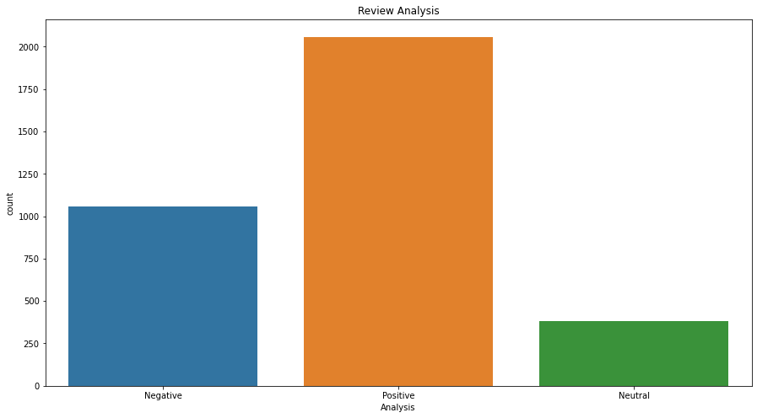
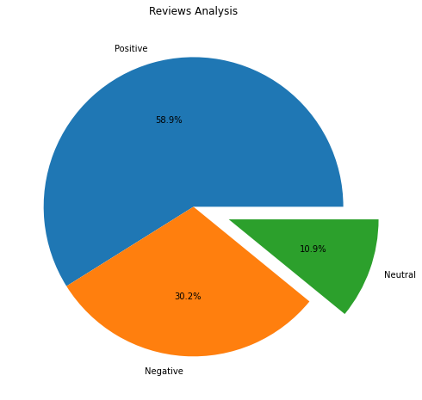
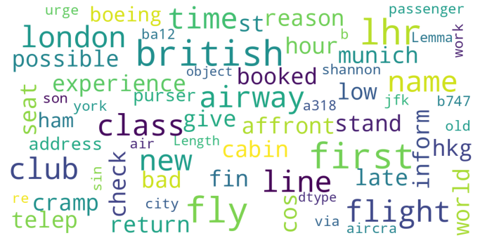
FINDING MEANINGFUL INSIGHT FROM CUSTOMER REVIEWS
Fetching 100 Pages Data and get 3494 Clean Reviews Given by the Customers
Positive Reviews : 2058
Negative Reviews : 1055
Neutral Reviews : 381

